Slide 1
Chicago Bears
Custom COVID Daily Screener & Thermal Scanner Process

Slide 2
2020 Spring/Summer Timeline
March 13th
Apr 23-25th
May 19th
June 15th
Entire organization begins to work from home
First virtual draft in NFL history. All personnel worked remote.
(Zero IT issues)
First internal IT Return to Work – Tech Planning meeting.
Illinois stay at home order ended at the end of May
Coaching & limited staff begin to return to headquarters in limited numbers
APP DEADLINE

Slide 3
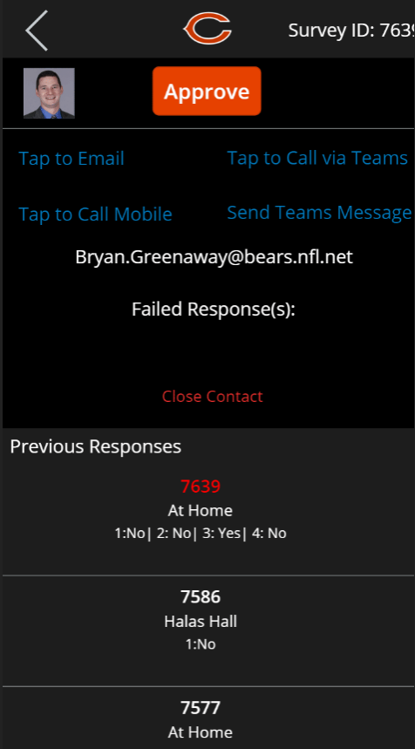
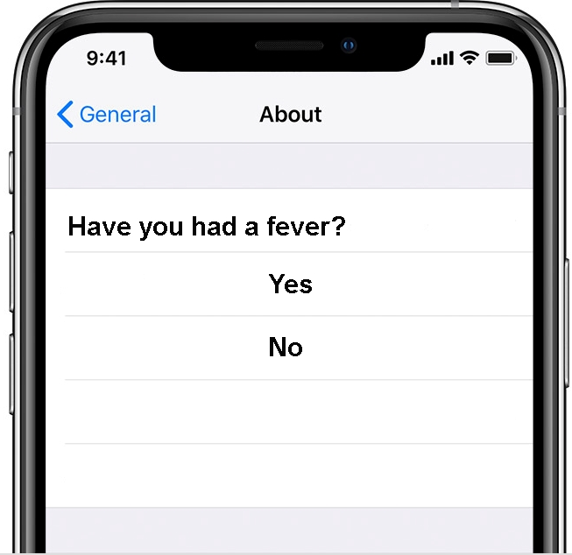
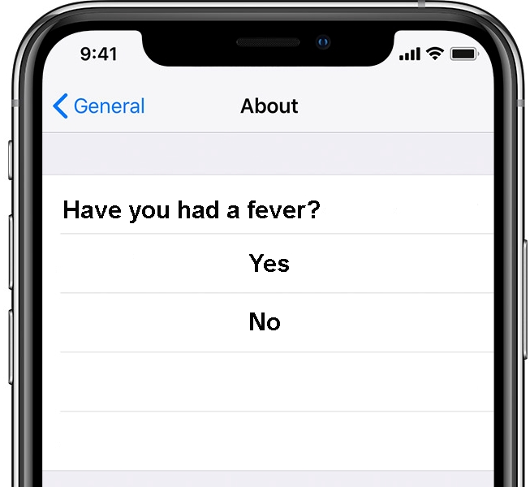
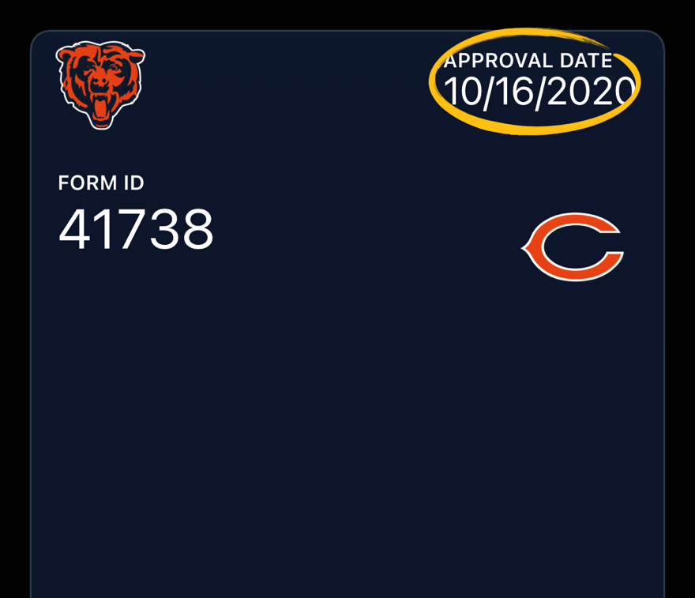
Chicago Bears COVID Screening Process
1. At Home Questionnaire
2. On-site Thermal Scanning
3. Response Review App
From your residence, complete questionnaire via link provided by HR
Wait until you receive approval before traveling to Halas Hall
If you do not receive approval, please contact HR. Do not travel to Halas Hall at this point.
Pull up to the guard shack and present your phone with the day pass visible to the guard
Approach the temperature scanning station
Scanner uses facial recognition to identify the person, and logs a pass/fail based on their temperature
For any flagged user from the form or thermal scanner, a notification is sent to our ICO and HR.
Due to the nature of the data we don’t include any information in the notification
Instead they can review submissions via a custom PowerApp and manually approve any flagged user
Temperature Screening

Slide 4
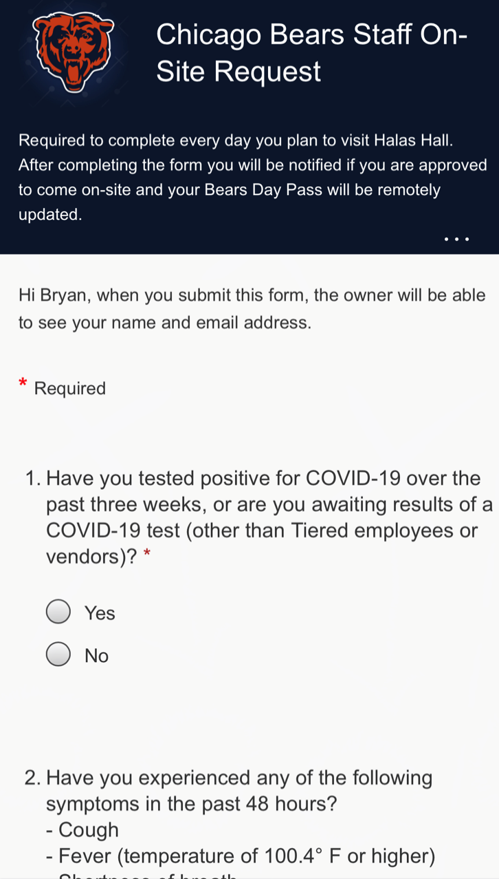
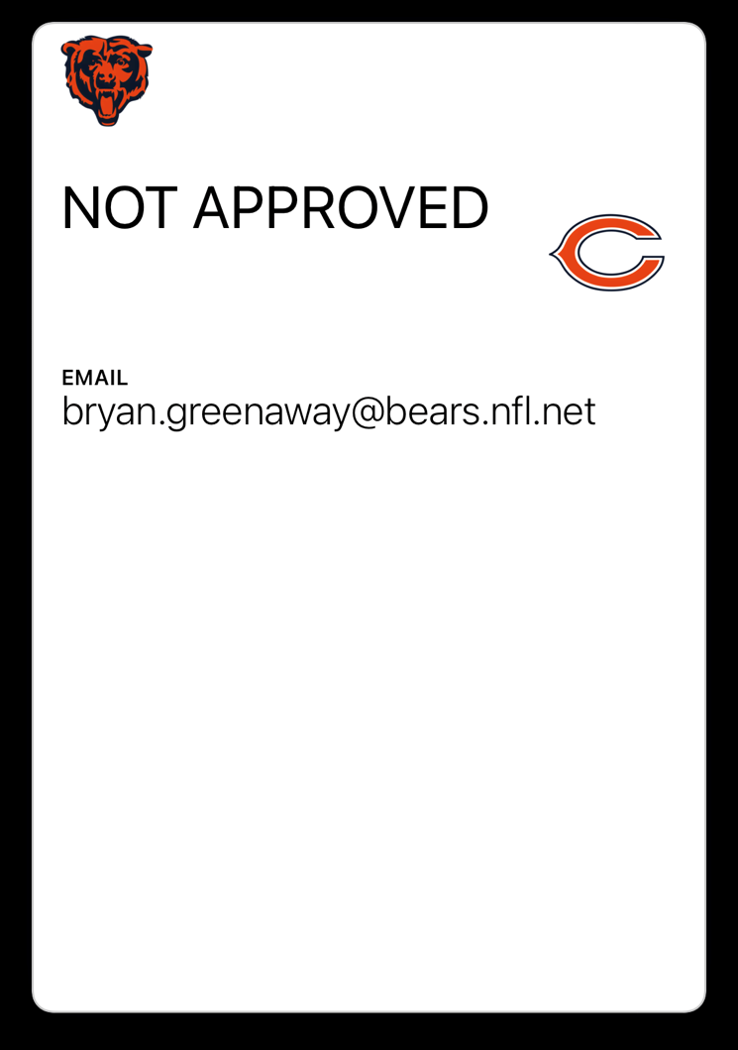
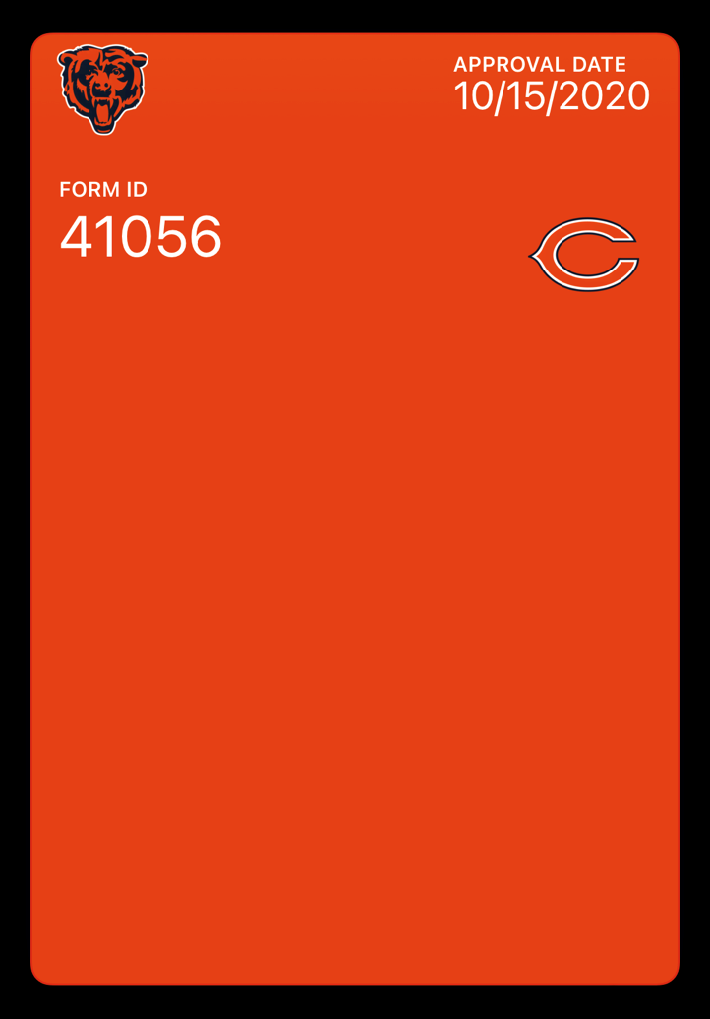
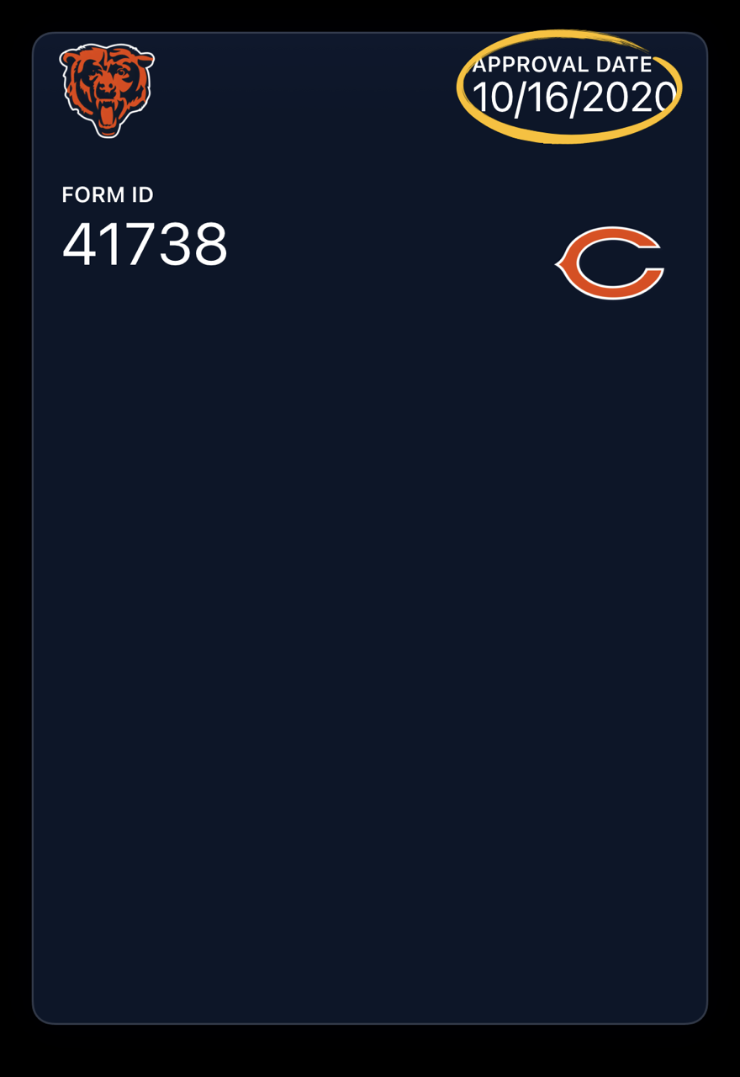
Screen Shots – Questionnaire & Day Pass
Questionnaire
Not Approved Day Pass
Approval Push Notification
Approved Day Pass

Slide 5
Thermal Scanner Demo

Slide 6
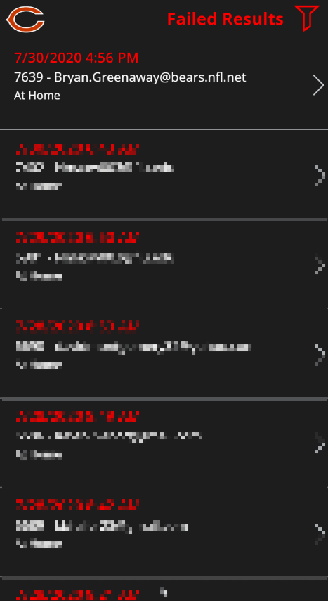
#3 –
Response Review PowerApp – Short Demo

Slide 7
Response Review PowerApp – Screenshot

Slide 8
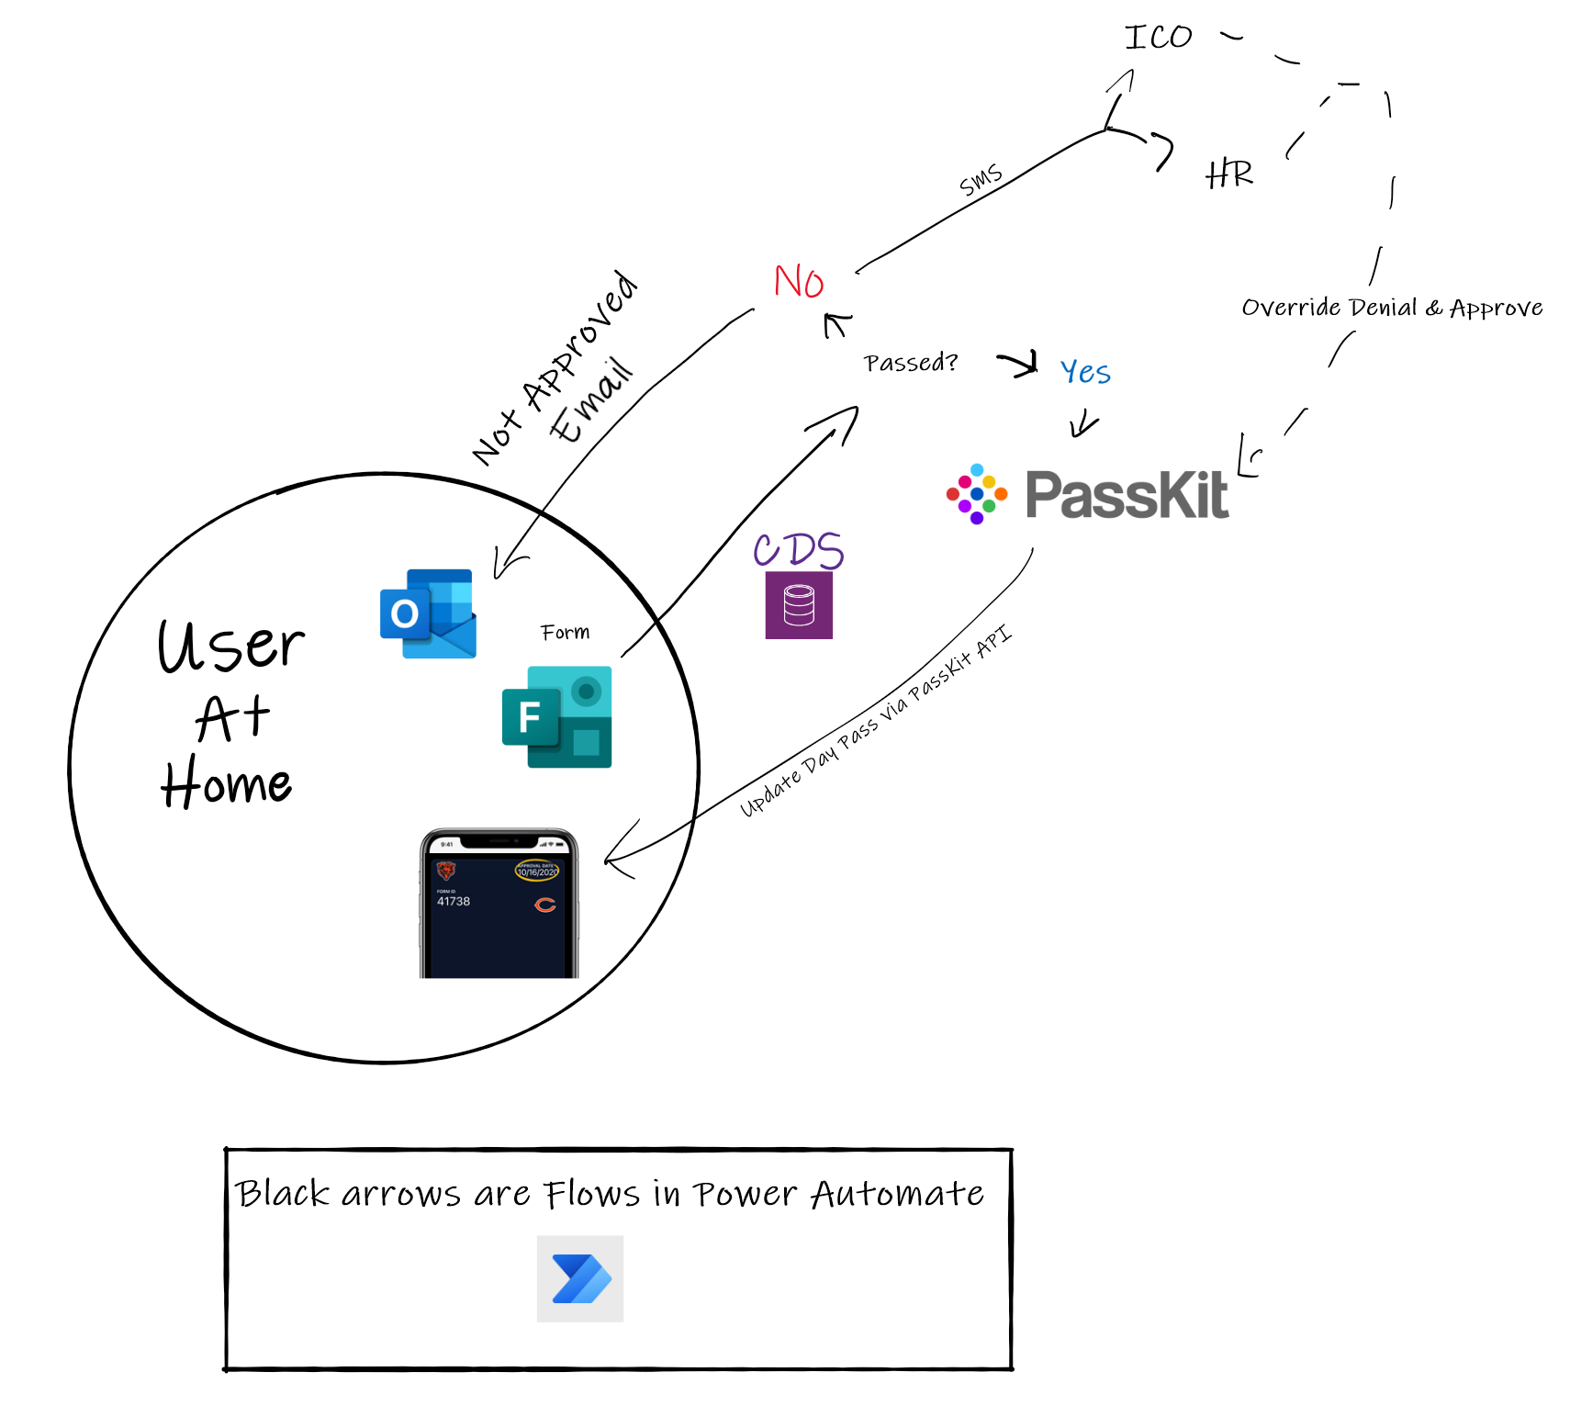
High Level Diagram – At Home Questionnaire

Slide 9
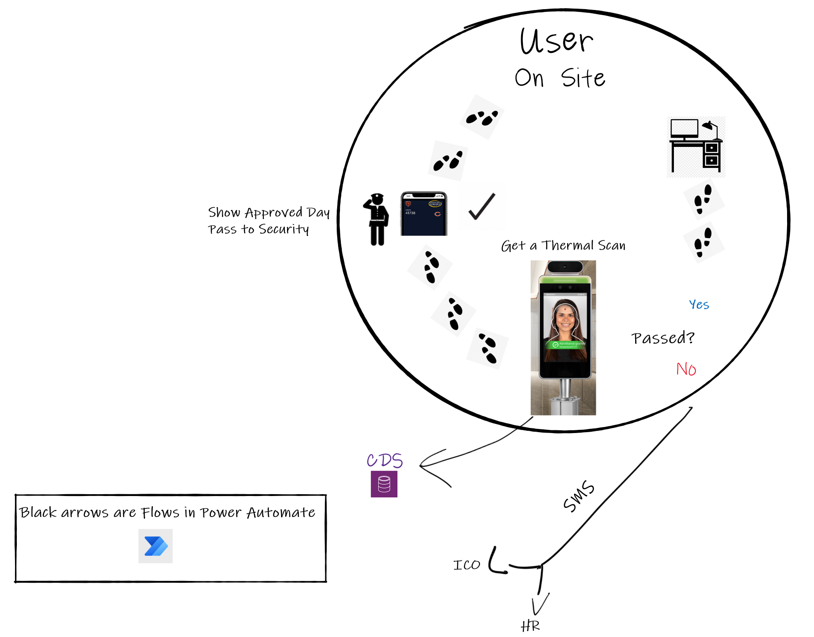
High Level Diagram On Site

Slide 10
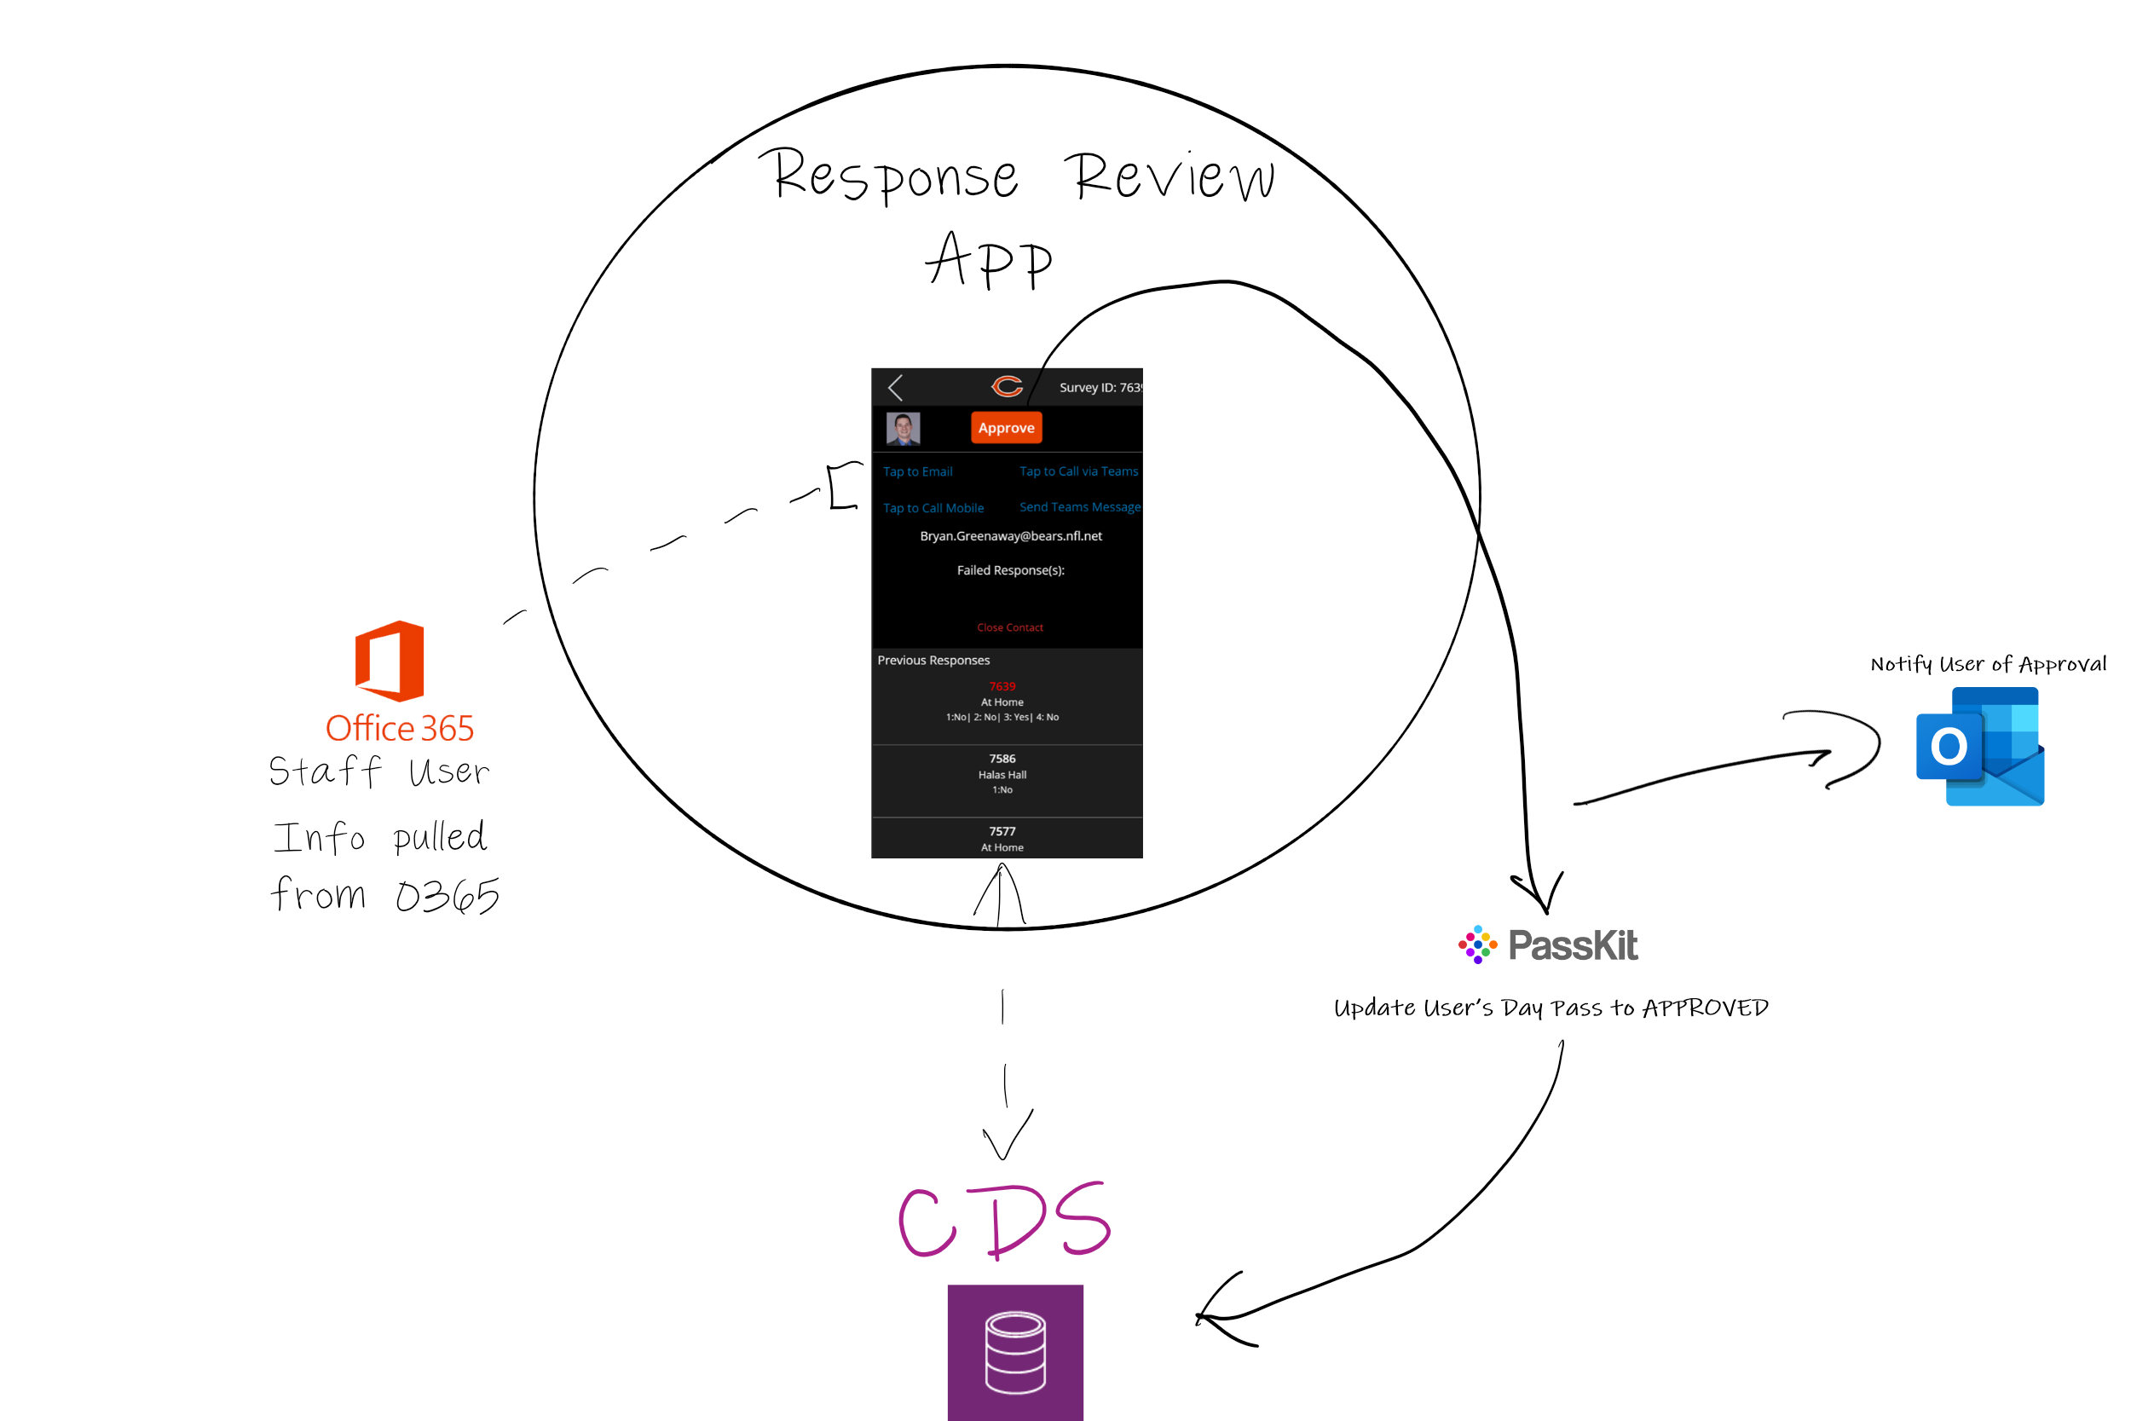
High Level Diagram Response Review App

Slide 11
Services Used
Daily Questionnaire | Microsoft Forms
Data Storage | Common Data Service
Backend Processes | Power Automate
Review App | Power Apps
Mobile Pass | https://passkit.com
Thermal Scanner | https://cri.com/
Twilio | https://twilio.com

